Slide 1

Model-driven Sketch Reconstruction with Structure-oriented Retrieval
Lei Li¹ Zhe Huang² Changqing Zou^{3,4} Chiew-Lan Tai¹ Rynson W.H. Lau²
Hao (Richard) Zhang³ Ping Tan³ Hongbo Fu²
¹Hong Kong University of Science and Technology
²City University of Hong Kong
³Simon Fraser University
⁴Hengyang Normal University
Notes:
Thanks for the introduction. I will be presenting our work on model-driven sketch reconstruction with structure-oriented retrieval.

Slide 2
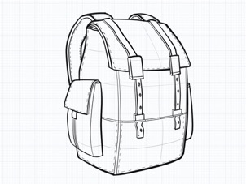
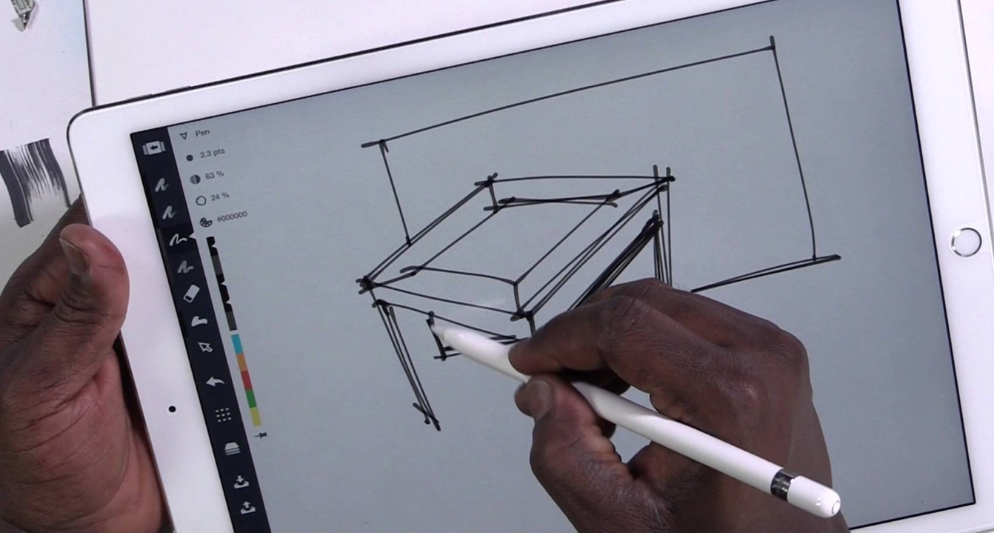
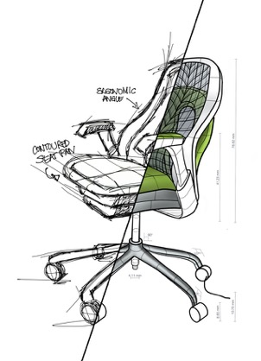
Background
2D sketching tools
Notes:
2D sketches are commonly used to convey ideas or concepts. It would be more pleasing to have 3D versions of these drawings to interact with and to view from different angles. However, transforming 2D drawings into 3D is an extremely challenging task, because sketches can too ambiguous and rough to support the transformation.
---
https://concepts.tophatch.com/
https://www.youtube.com/watch?v=TYowudm697c

Slide 3
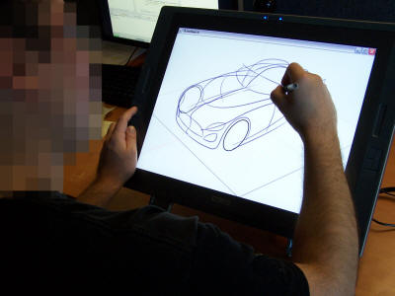
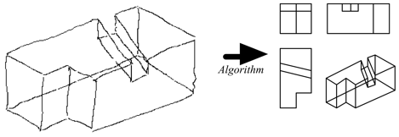
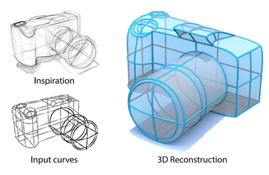
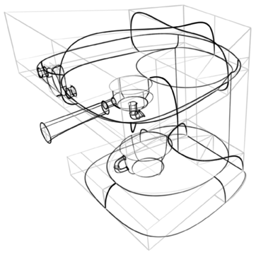
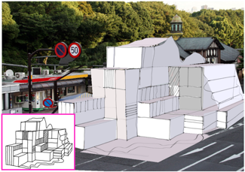
Related work
Interactive 3D sketching
Reconstruction from completed sketch
[Lipson et al. 1996]
ILoveSketch [Bae et al. 2008]
True2Form [Xu et al. 2014]
[Schmidt et al. 2009]
SmartCanvas [Zheng et al. 2016]
Notes:
There exist mainly two categories of work to solve the 2D-to-3D sketch transformation problem. The first category is interactive 3D sketching. Systems in this category typically require users to interactively draw additional lines or gestures to serve as constraints before inferring the 3D geometry. <Click> The second category is reconstructing 3D sketch after user’s creation. This line of work usually requires clean and accurate drawings or predefined 3D information knowledge.

Slide 4
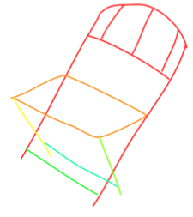
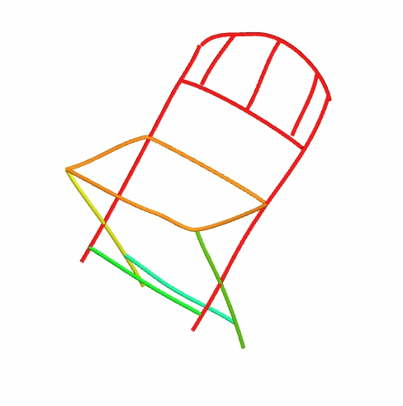
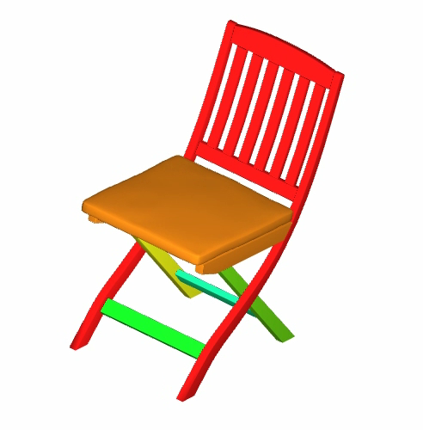
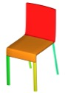
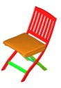
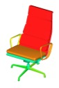
Our work
2D sketch
3D sketch
Model-driven sketch reconstruction
3D model
Retrieval
…
Database
Notes:
Our work belongs to the second category, but we take a different approach to reconstructing 3D sketches after user’s creation. We use existing 3D model collections to facilitate the transformation of 2D drawings into 3D. Our work is an initial attempt to use a template-based approach to solving such a problem.

Slide 5
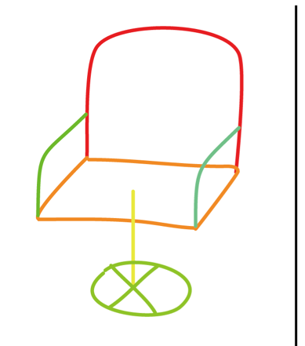
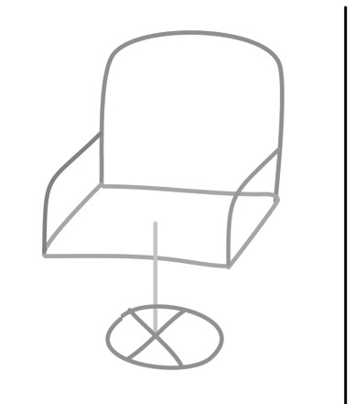
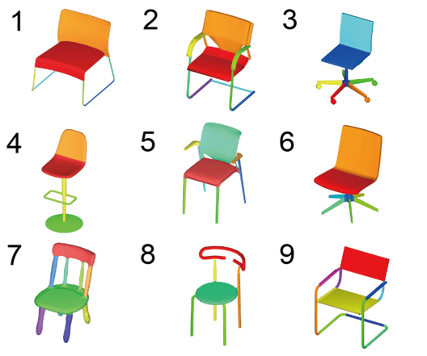
Problems to solve
Sketch-based 3D model retrieval:
Similar structure
Similar shape
Sketch
Retrieval [Eitz et al. 2012]
Structure
Notes:
We have several problems to solve if we use 3D model collections in the sketch reconstruction. First, given the input sketch, we need to find a similar 3D model in the database. Our requirement is that the retrieved 3D model should be not only structure similar, but also shape similar to the input sketch. Existing methods, for example, [Eitz et al.], mostly consider shape features. The retrieval results of their method are less desirable in terms of structure similarity. <Click> We observe that annotation of stroke connection in the sketch is a relatively easy task for the user, but it would provide the important structure information of the sketched object, which could improve the retrieval process. So we devise a structure-oriented retrieval method to better suit our needs.

Slide 6
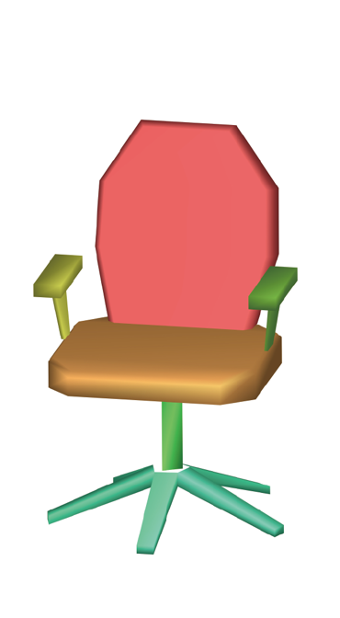
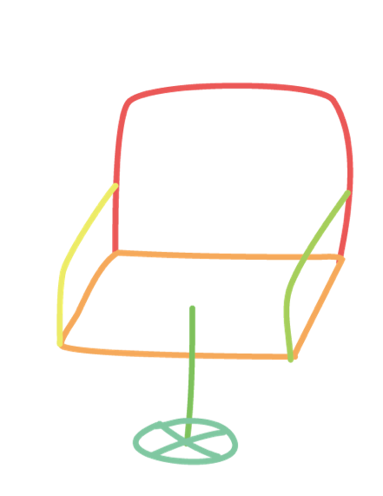
Problems to solve
Sketch reconstruction
Correspondences between parts;
Lifting 2D sketch parts into 3D using model parts.
Sketch parts
Model parts
Notes:
The input sketch is drawn part by part to provide the structure information for the retrieval. After the user selects a 3D model from the retrieval results, the correspondences between parts of the sketch and the model are required, so that the model parts can serve as guidance for lifting the sketch into 3D. Fortunately, our structure-oriented retrieval method can produce the initial correspondences to bootstrap the sketch reconstruction procedure. In the picture, the colors indicate segmentations and correspondences of the sketch and the 3D model.

Slide 7

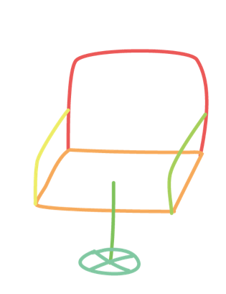
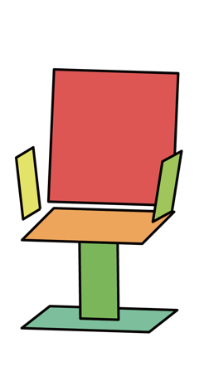
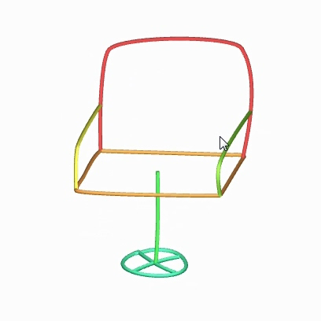

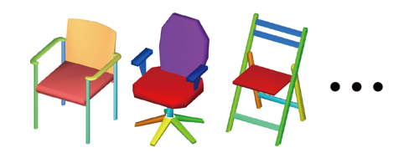
Pipeline
Model retrieval
Sketch reconstruction
Sketch
Retrieved Model
Extracted Planes
Reconstruction
result
Model Database
Notes:
This is the pipeline of our system. It has two stages, model retrieval and sketch reconstruction. Given the input sketch drawn part by part, we find a structure and shape similar 3D model from the database. We assume each sketch part lies on a 3D plane. So we extract a 3D plane from its corresponding model part and do back-projection, followed by a reconstruction optimization procedure based on the Laplacian mesh deformation framework. <Click> Next I’ll talk about the model retrieval stage. <Click> The input sketch is annotated with connections among the strokes by the user. <Click> The models in the database are pre-segmented and rendered into contour images.

Slide 8
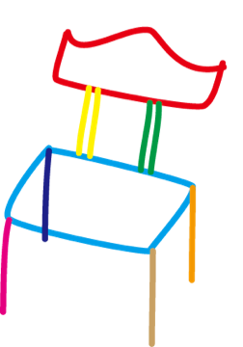
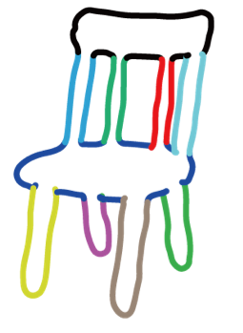
Model retrieval
Evaluate similarity between sketch and contour image of a 3D model.
Two criteria:
Structure matching cost
Shape matching cost
Similarity
,
Sketch
Model Contour
Notes:
The key step of the model retrieval stage is to evaluate the similarity between the input sketch and the contour image of a 3D model. As I mentioned earlier, existing retrieval methods don’t have the structure of the sketched object as input. Now with the input sketch drawn part by part and connection annotations by the user, we can consider two criteria in this process: structure matching and shape matching. I will give more details of each criterion.

Slide 9
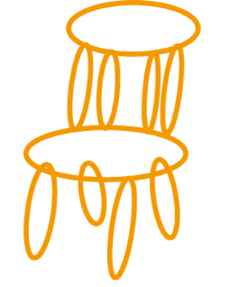
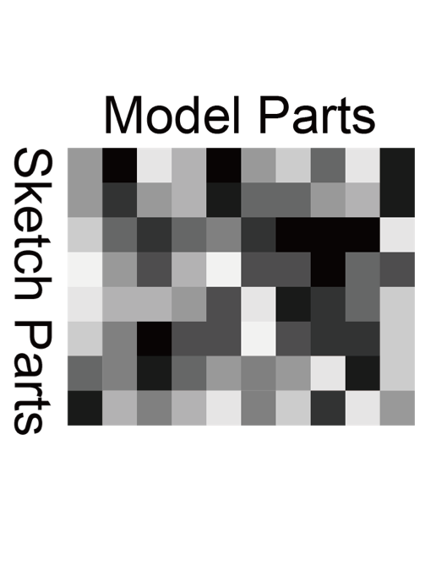
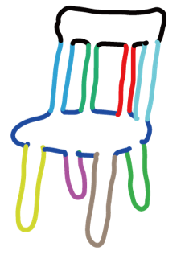
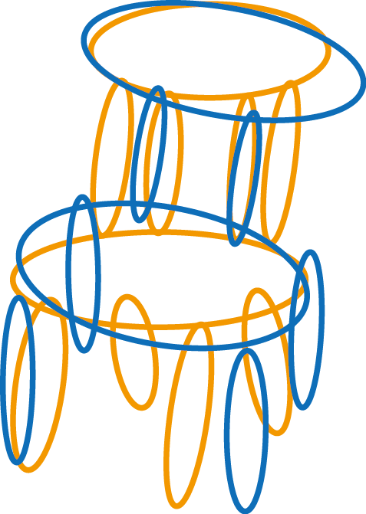
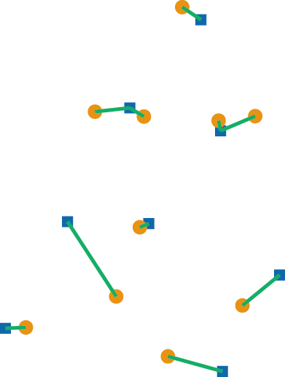
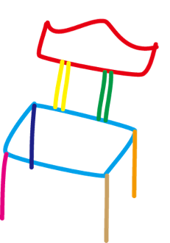
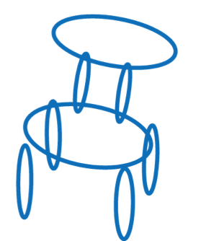
Model retrieval
Structure matching cost
1) Find correspondences 2) Evaluate structure similarity
Model Contour
Correspondences
Sketch
( Pairwise cost considers positions and sizes. )
( Iterative linear assignment )
Notes:
Before evaluating the structure similarity, we first find correspondences between the parts of the sketch and the model. <Click> The observation is that if we superimpose the sketch on the model contour, corresponding parts should be close to each other; and the shapes of the corresponding parts should be similar. So we replace each part by a best-fit ellipse. The pairwise cost for matching a sketch part to a model part is the weighted sum of the distance and shape difference of their best-fit ellipses. With the pairwise cost, we iteratively apply a linear assignment method to compute the correspondences.

Slide 10
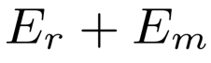
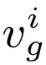
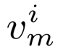
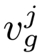
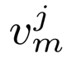
Model retrieval
Structure matching cost:
1) Find correspondences 2) Evaluate structure similarity
Relative position:
p(·) : position
Sketch
Model Contour
Notes:
With the correspondences from the previous step, we are ready to evaluate the structure similarity between the sketch and the projection of a model. The similarity measurement considers two factors: relative position E_r and part merging E_m. <Click> More specifically, E_r is defined as the difference of relative positions of two adjacent parts in the sketch and their corresponding model parts. The adjacency of sketch parts is derived from the connections annotated by the user.

Slide 11
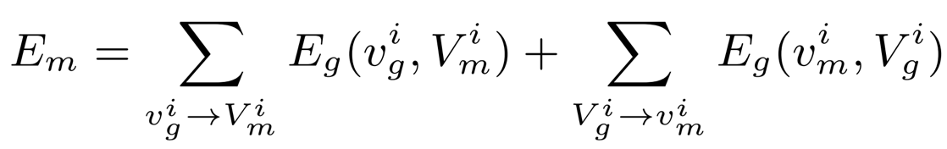
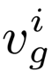
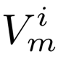
Model retrieval
Structure matching cost:
1) Find correspondences 2) Evaluate structure similarity
Part merging:
One to many
Many to one
MST
Sketch Part
Model Contour
Notes:
As you can imagine, one sketch part may correspond to several model parts or the other way around, because of segmentation granularity of the database models or incorrect correspondence computation. We use a part merging cost E_m to deal with such problems. <Click> For example, in the first part of E_m where one sketch part corresponds to several model parts, we compute a minimum spanning tree to connect the model parts. Then, the total edge weight of the MST and the difference of their overall best-fit ellipses are used to define E_g. For more details, please refer to our paper.

Slide 12
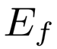
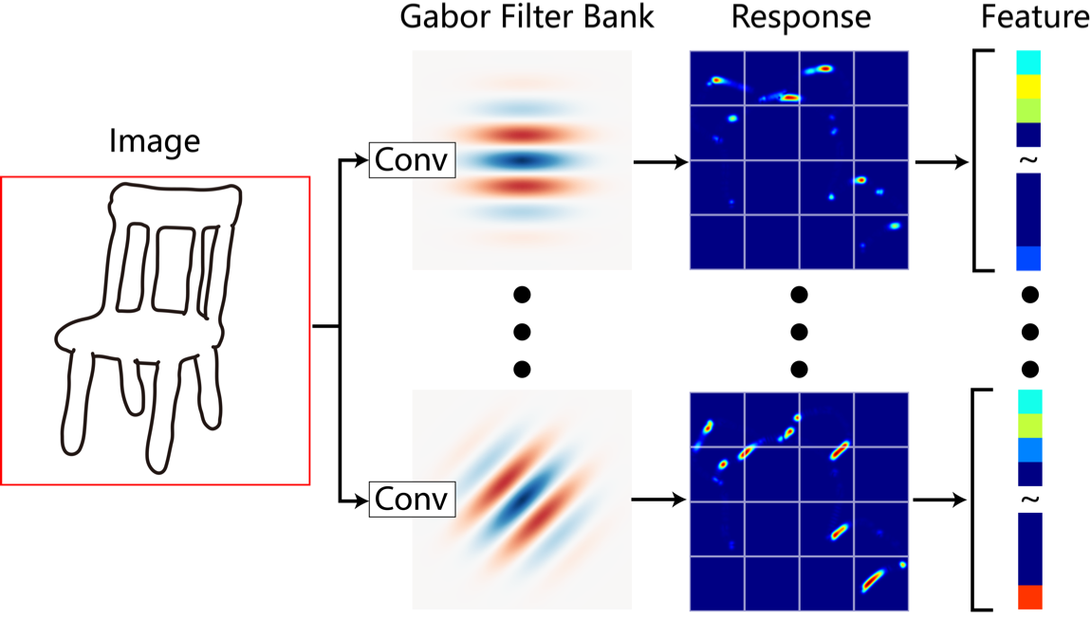
Model retrieval
Shape matching cost:
Use Gabor feature [Eitz et al. 2012]
Notes:
The second criterion in the model retrieval process is the shape matching. It is used to compare shape features of the sketch image and the contour image of a model. We adopt the traditional Gabor feature and define the shape matching cost E_f as the cosine distance between the two image feature vectors.

Slide 13
Model retrieval
Evaluate similarity between sketch and projected contours of a 3D model.
Two criteria:
Structure matching cost:
Shape matching cost:
Similarity
,
Sketch
Model Contour
Notes:
The complete matching cost of comparing a sketch with the contour of a database model is the weighted sum of the structure cost and the shape cost. The retrieved models are finally returned as a ranked list based on the complete matching cost.

Slide 14
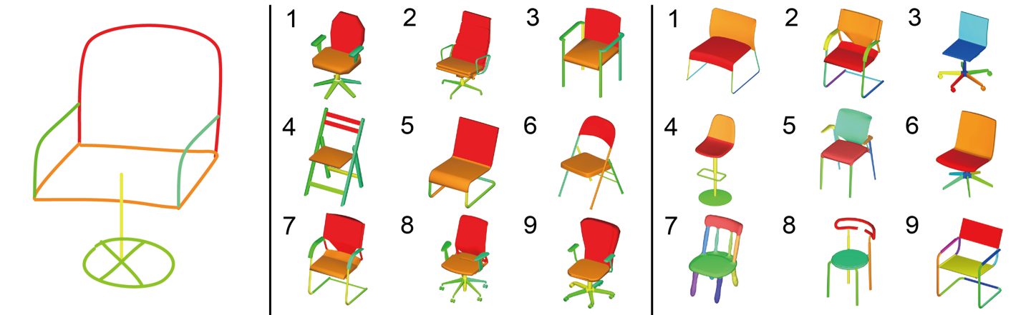
Model retrieval
Qualitative retrieval comparison
Input Sketch
Our method
[Eitz et al. 2012]
Notes:
Here are some qualitative retrieval comparison results with the method of [Eitz et al], since the input of [Eitz et al]’s method is the rasterized sketch image and doesn’t require the strokes’ connection annotations. <Click>
--
Each column from left to right: the input sketch, the results of our method, the results of [Eitz et al. 2012].

Slide 15
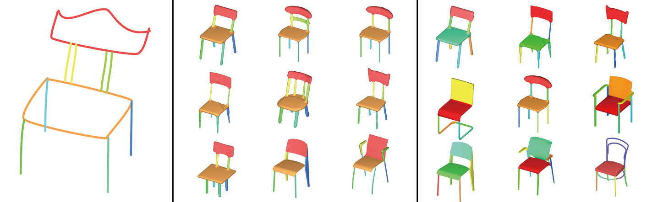
Model retrieval
Qualitative retrieval comparison
Input Sketch
Our method
[Eitz et al. 2012]
Notes:
<auto>

Slide 16
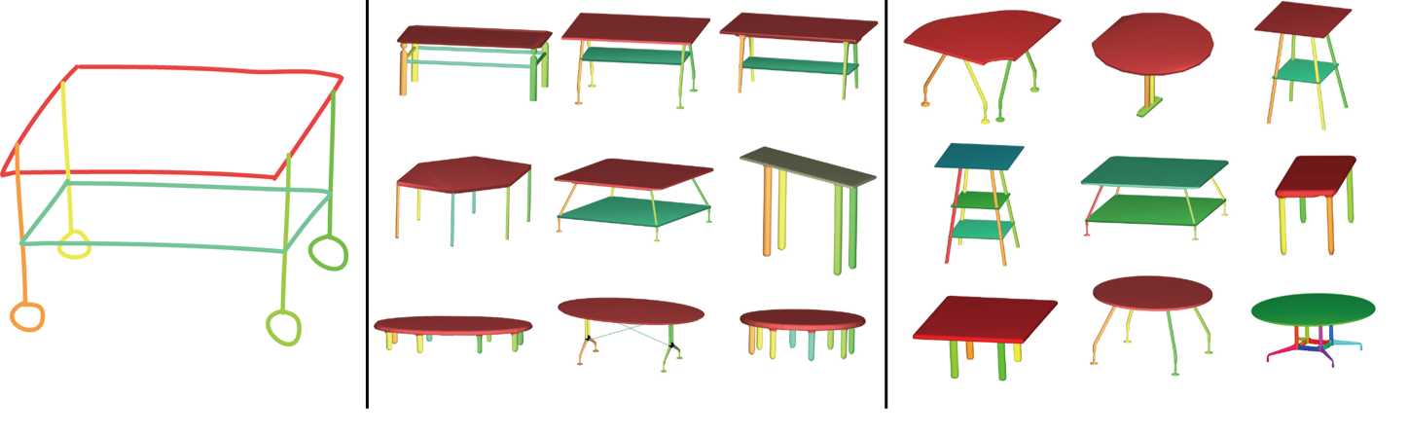
Model retrieval
Qualitative retrieval comparison
Input Sketch
Our method
[Eitz et al. 2012]
Notes:
<auto>

Slide 17
Pipeline
Model retrieval
Sketch reconstruction
Sketch
Retrieved Model
Extracted Planes
Reconstruction
Model Database
Notes:
Next I will talk about the second stage, sketch reconstruction.

Slide 18
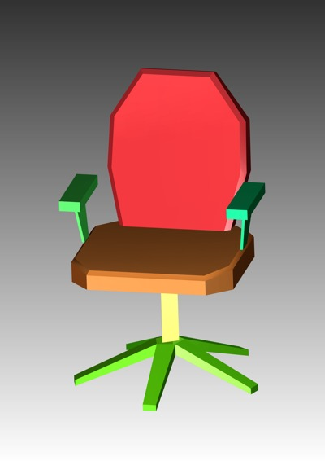
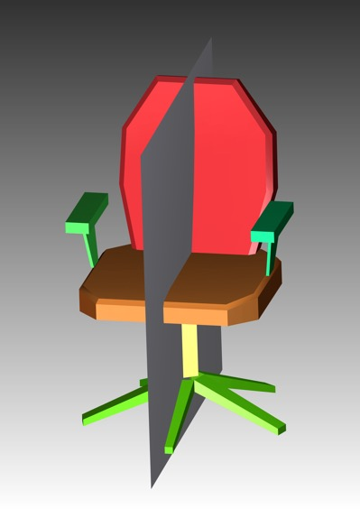
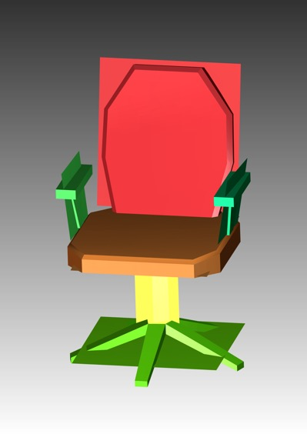
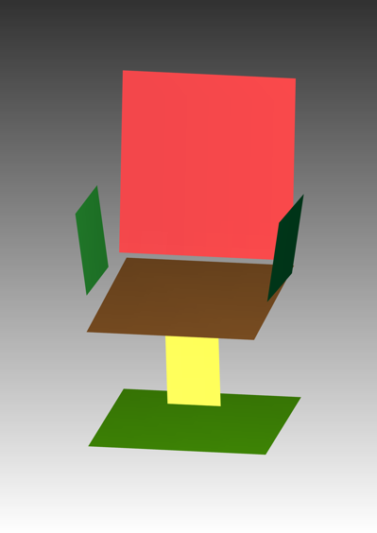
Sketch reconstruction
Two steps for lifting sketch into 3D:
3D plane generation from a model
Back-projection and optimization
Reflective symmetry
User selected model
Notes:
There are two steps for lifting the sketch into 3D with a model. In our work, for each sketch part, we choose to extract a 3D plane from the corresponding model part. We utilize the computed correspondences from the retrieval stage and let the user fix any wrong correspondence. We use a greedy, PCA based scheme to generate a candidate plane set for each sketch part, <Click> with consideration of reflective symmetry in the model if it exists. <Click> The greedy rule for selecting a plane from the candidate set is to choose the plane with the minimum angular difference between its normal and the view direction. Because a large angular difference would increase the foreshortening perception bias and reduce the plausibility of back-projection.
--
More advanced plane extraction method[McCrae el al. 2011] can also be used here.

Slide 19

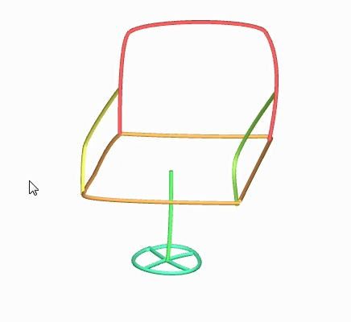


Sketch reconstruction
Two steps for lifting sketch into 3D:
3D plane generation from a model
Back-projection and optimization
y
x
Initial back-projection result
z
Notes:
Next we back-project each sketch part to its corresponding 3D plane, extracted from the model. However, this naïve approach produces disconnected and undesirable result, because of users’ imprecise drawing and foreshortening bias. We use a mesh deformation method to reduce the problems. <Click> So, each sketch part is triangulated into a mesh before the back-projection.

Slide 20
Sketch reconstruction
Two steps for lifting sketch into 3D:
3D plane generation from a model
Back-projection and optimization
Initial back-projection result
Optimized result
Notes:
Right hand side is the result after the optimization procedure.

Slide 21




Sketch reconstruction
Two steps for lifting sketch into 3D:
3D plane generation from a model
Back-projection and optimization
Laplacian mesh deformation [Sorkine et al. 2004]
Additional constraints: , and
proximity
planarity
projection
Back-projection
Optimization
y
2D input stroke
Stroke
Stroke
Projection of 3D counterpart
Plane
x
Stroke
Meshes
Notes:
Specifically, we apply Laplacian mesh deformation to the back-projected meshes. Additionally, we add several constraints to guide the deformation result. <Click> Proximity constraint is to penalize disconnections, that is, the distance among connectors annotated by the user. <Click> Planarity is to constrain 3D strokes from being non-planar. It is defined as the sum of distances of points on the stroke to the plane. <Click> Projection constraint is to keep resemblance between the sketch and the 2D projection of the reconstructed result. It is defined as the difference in the xy-plane between the sketch and the projection of its 3D counterpart.

Slide 22






Results
Input sketch
Retrieved model
Initial back-projection
result
Optimized result
Notes:
Here are some reconstruction results. The last column is the final optimized 3D sketch.
--
Five categories of man-made objects to form the database, which contains 72 chairs, 54 tables, 45 airplanes, 20 glasses and 20 lamps.

Slide 23






Results
Input sketch
Retrieved model
Initial back-projection
result
Optimized result

Slide 24






Results
Input sketch
Retrieved model
Initial back-projection
result
Optimized result

Slide 25

Limitations
Richness of 3D models in the database;
Non-planar strokes.
Notes:
Our system is limited by the richness of 3D models in the database to handle different sketches. And due to our assumptions about sketch parts, we cannot deal with non-planar strokes.

Slide 26
Summary
Applied shape collections to the analysis and reconstruction of rough sketches;
Developed a structure-oriented shape retrieval algorithm;
Proposed an optimization procedure for 3D planar sketch reconstruction.
Notes:
To summarize, in this work, we applied shape collections to the analysis and reconstruction of rough sketches. We developed a structure-oriented shape retrieval algorithm; and proposed an optimization procedure for 3D planar sketch reconstruction.

Slide 27
Future work
Use a part-assembly approach [Shen et. al. 2012] to reduce the number of database models;
Incorporate more advanced plane generation methods.
Notes:
For future work, we could use a part-assembly approach to reduce the number of models in the database. We could also incorporate more advanced plane generation methods, or even directly use the model without the plane abstraction.

Slide 28
Thank you!
Acknowledgements:
Reviewers;
Funding agencies
(RGC of HKSAR, NSFC, NSF of Hunan Province, China).
Notes:
Finally I would like to thank the reviewers and funding agencies.
Thank you for your attention.

Slide 29
Notes:
Handle organic sketches.

Slide 30





More results
Input sketch
Retrieved models
Optimized results
View 1
View 2
Notes:
For a given input sketch, we use different models to reconstruct the 3D sketch.

Slide 31





More results
Input sketch
Retrieved models
Optimized results
View 1
View 2

Slide 32

Sketching
Notes:
This is a simple short video that shows how the user sketches in our system.

Slide 33





Failure case: imprecise view direction
Plane 1
Initial back-projection
result
Input sketch
Plane 2
Optimized result
Notes:
Here is a failure case. If the view of the model is different from the view of the sketch, either plane 1 nor plane 2 is suitable for the back-projection of the sketch part. Our plane generation process would select the plane one instead of plane 2, because of the angular difference of the plane normal and view direction. However, the initial back-projection result would be hard to optimize to get good results because of view inconsistancy.

